Slide 1
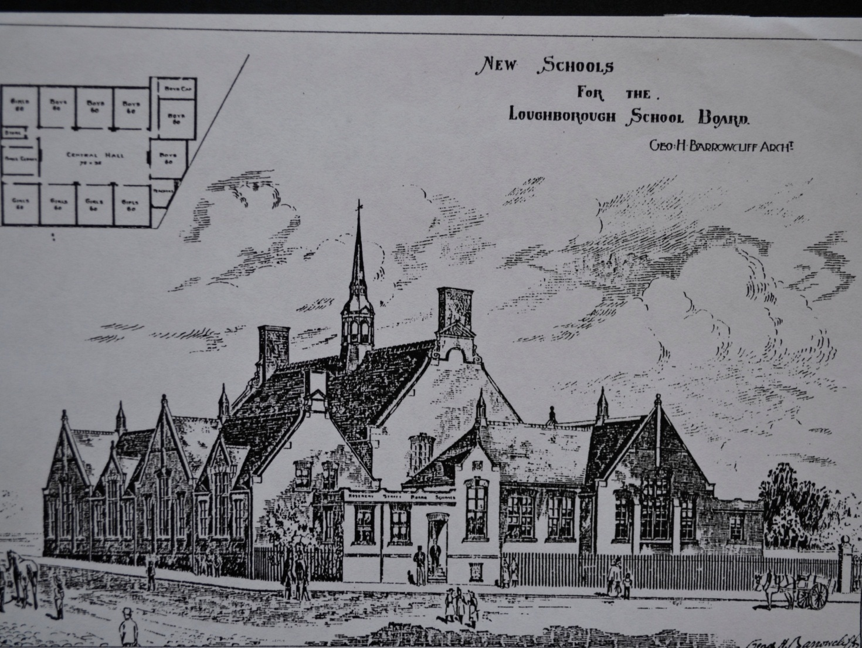
SOME NOTABLE Features of THE ROSEBERY BUILDING

Slide 2
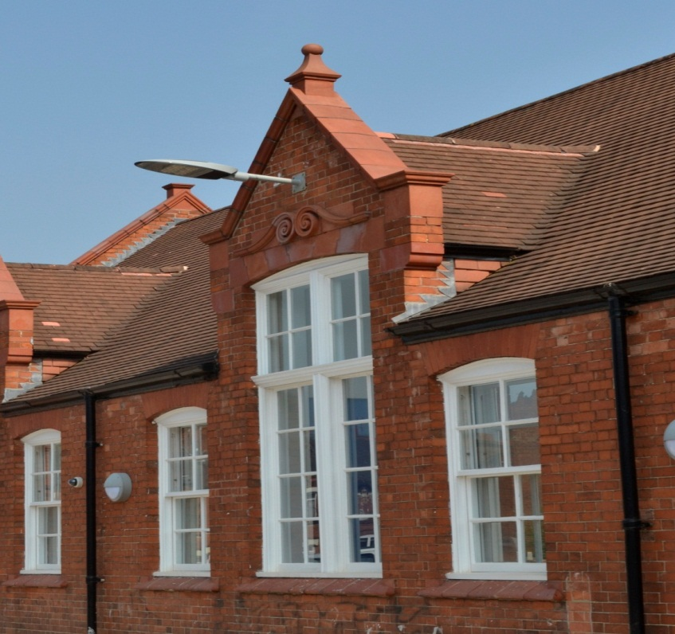
The Original Windows & terracotta mouldings
(19th Century sash windows)

Slide 3
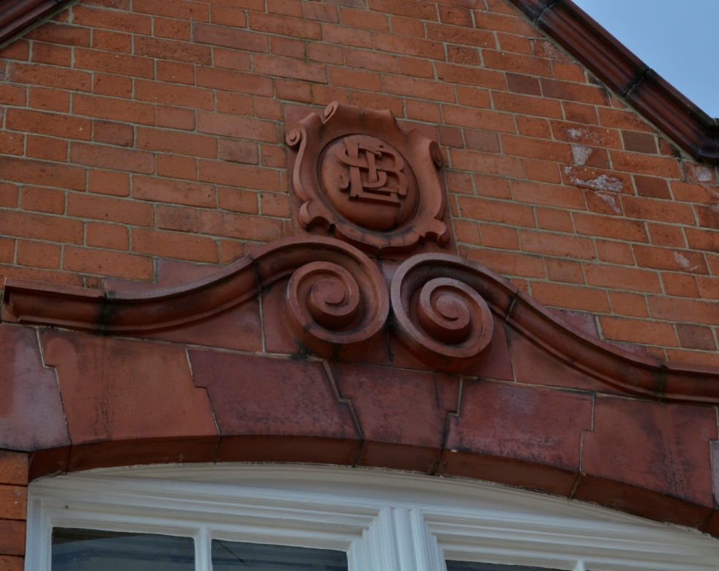
Loughborough School Board Cartouche & chimney stacks

Slide 4
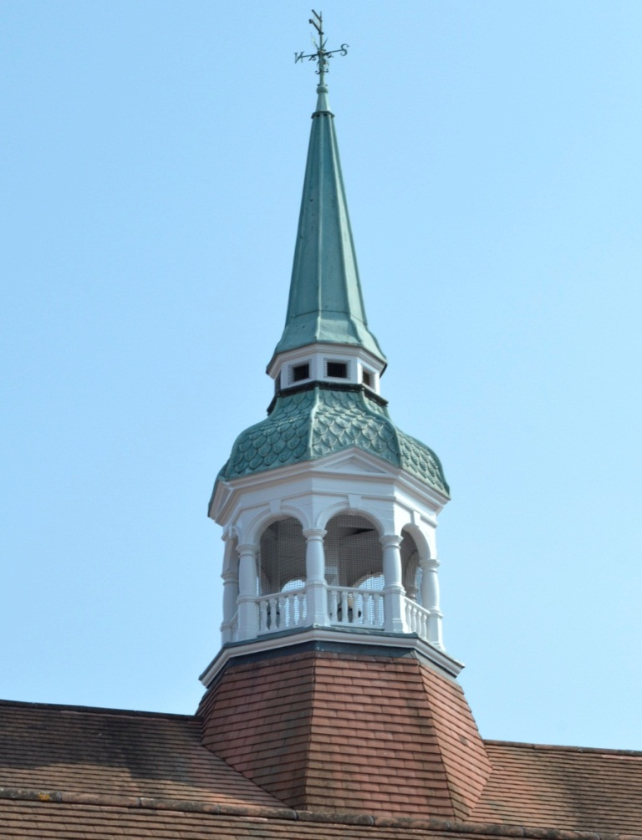
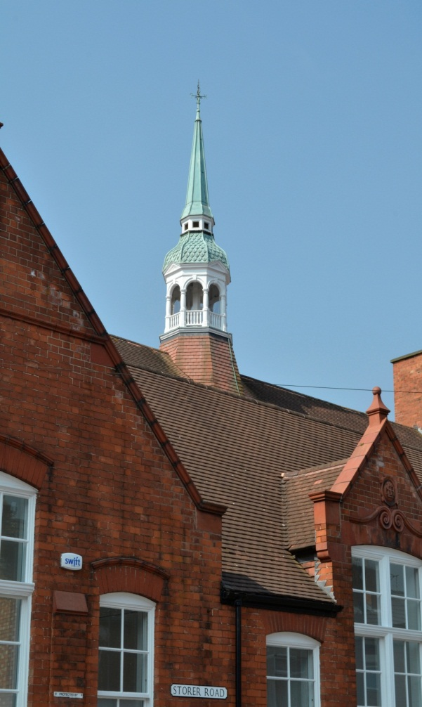
Bell-cote and Cupola
Octagonal wooden bell-cote with a cupola with copper fish scale tiles, surmounted by a copper-clad spire.

Slide 5
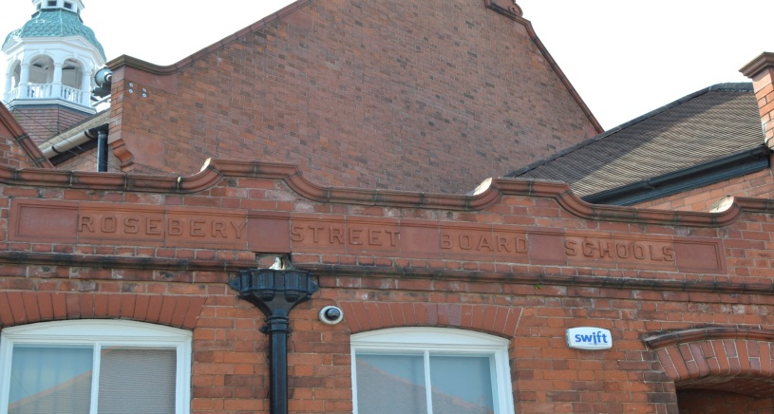
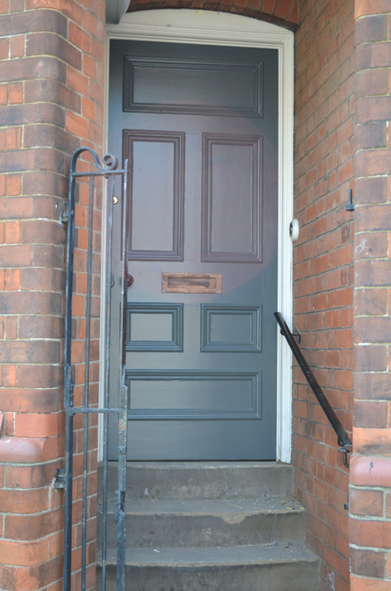
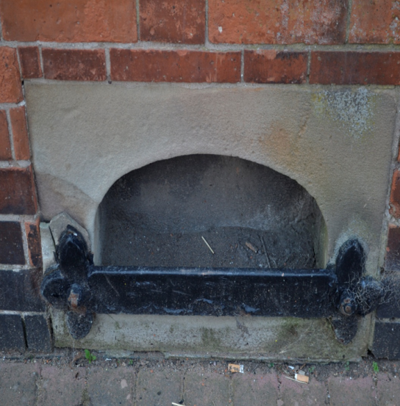
School Name Plaque, BOOT-SCRAPER AND ORIGINAL TEACHERS’ ENTRANCE

Slide 6
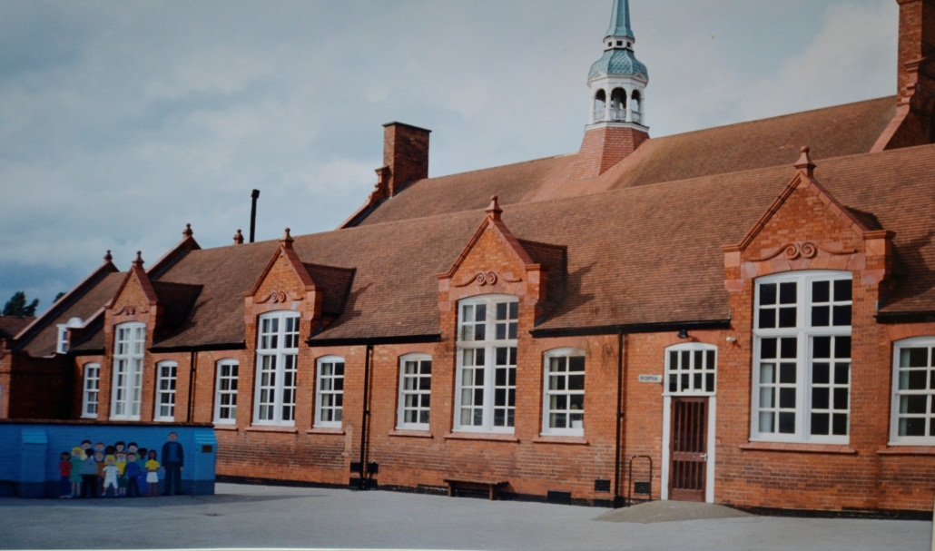
Playground (ORIGINAL WALL dividing Girls/Infants from Boys playgrounds REPLACED BY A TERRACOTTA LINE

Slide 7
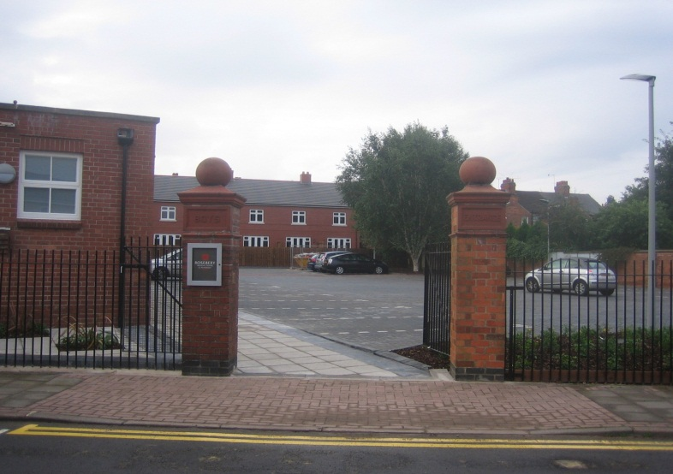
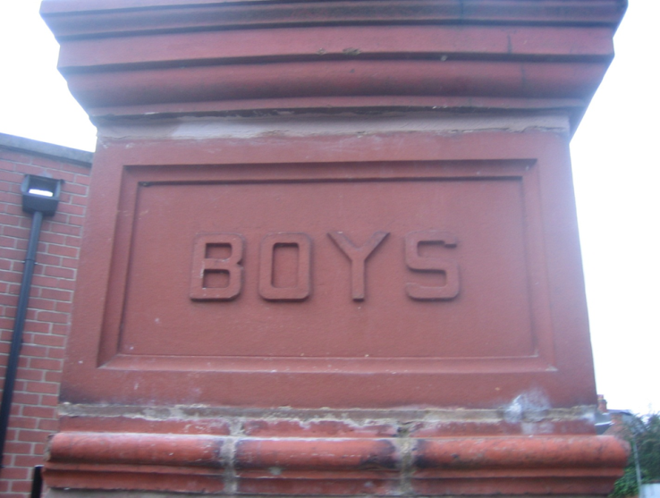
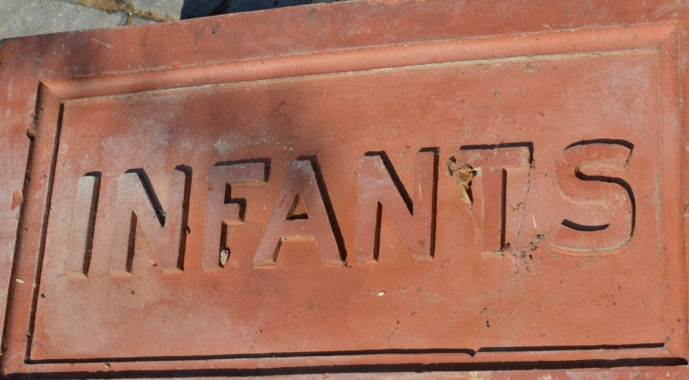
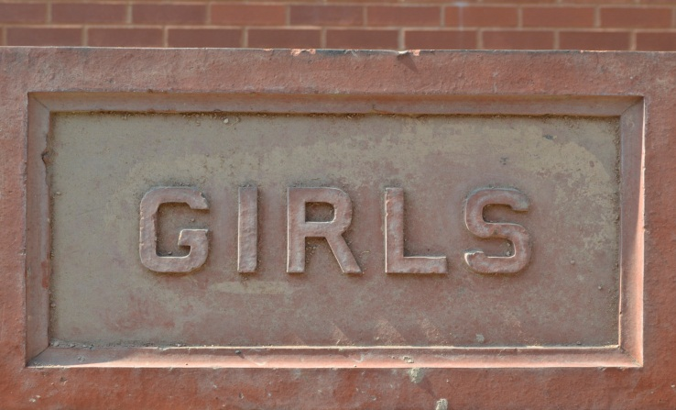
Red-brick gate piers, iron railings & original gate plaques

Slide 8
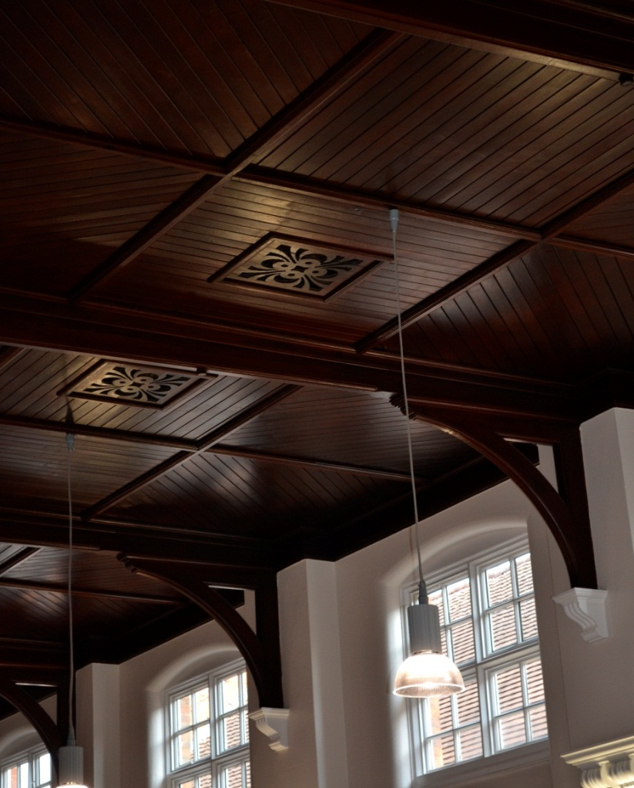
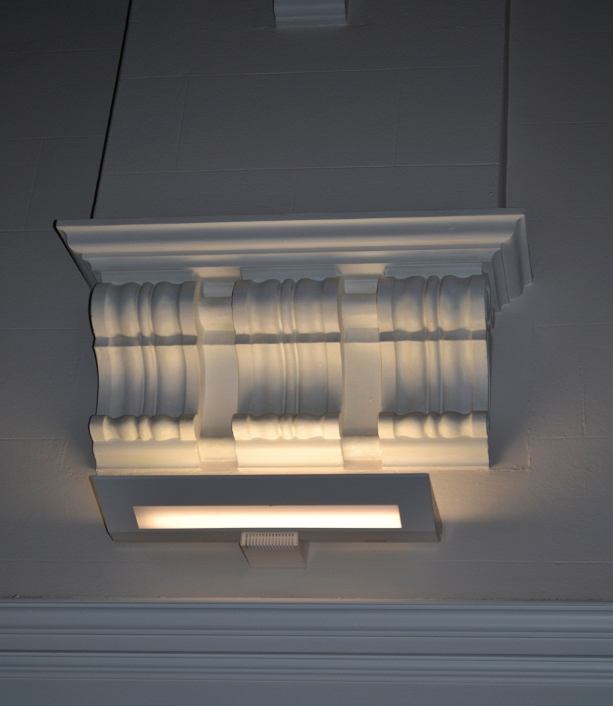
Wooden ceiling, Triple-scroll bracket & wooden buttress

Slide 9
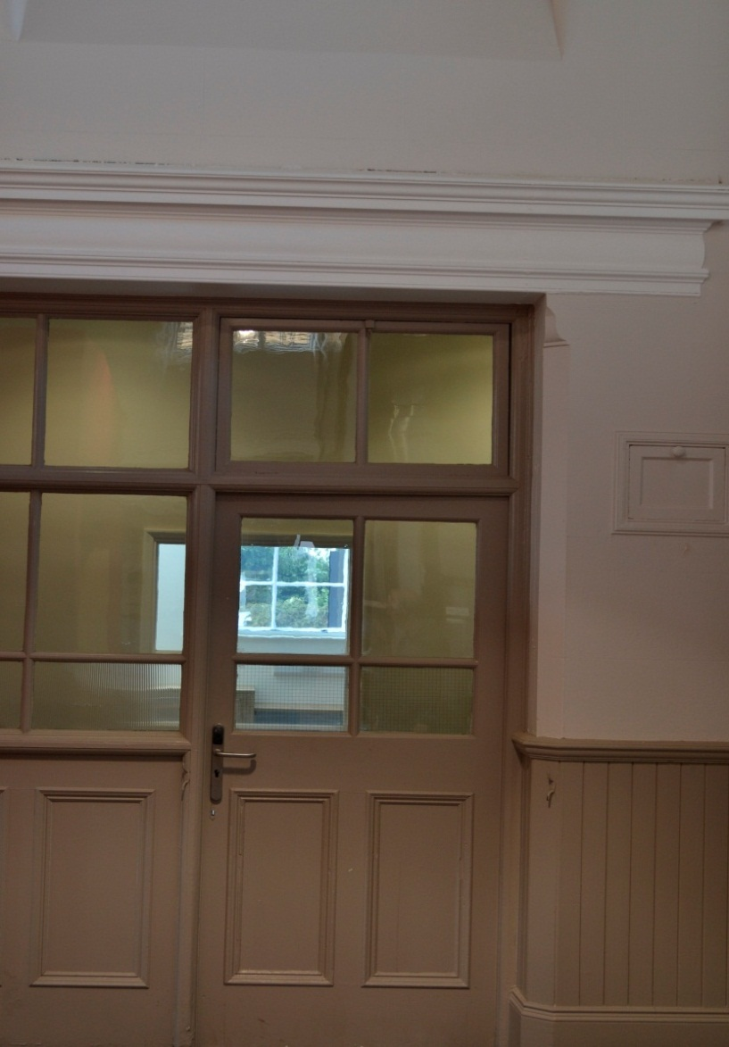
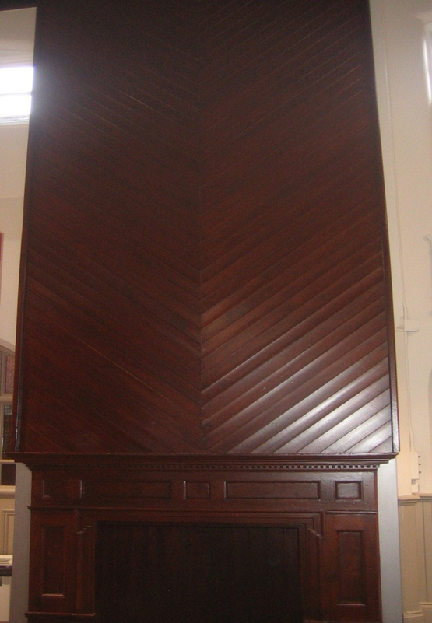
Glazed partitions to classrooms with a wide moulded cornice & original fireplace

Slide 10
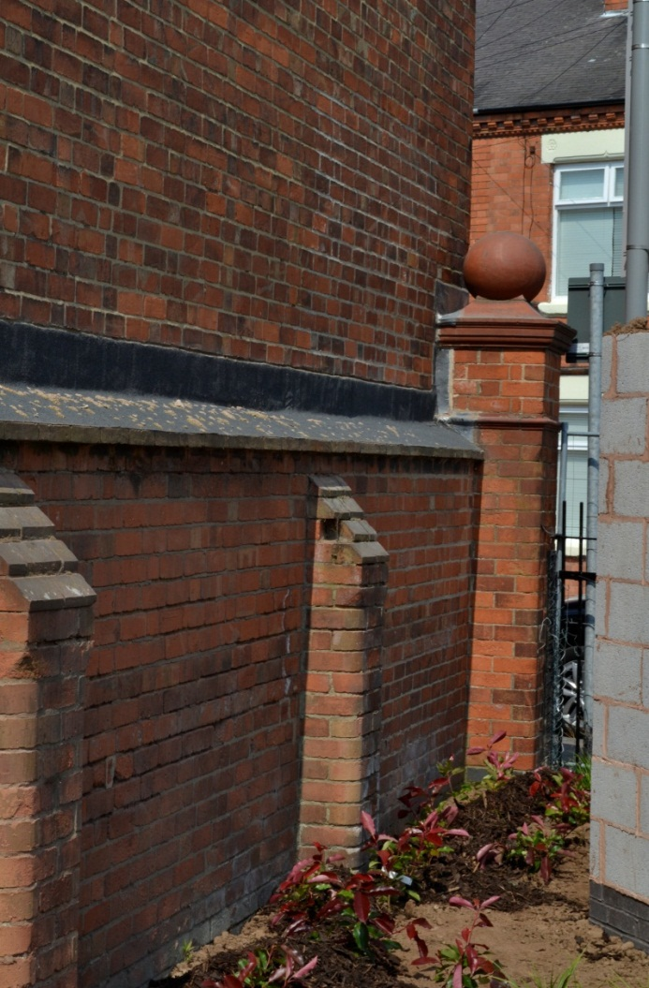
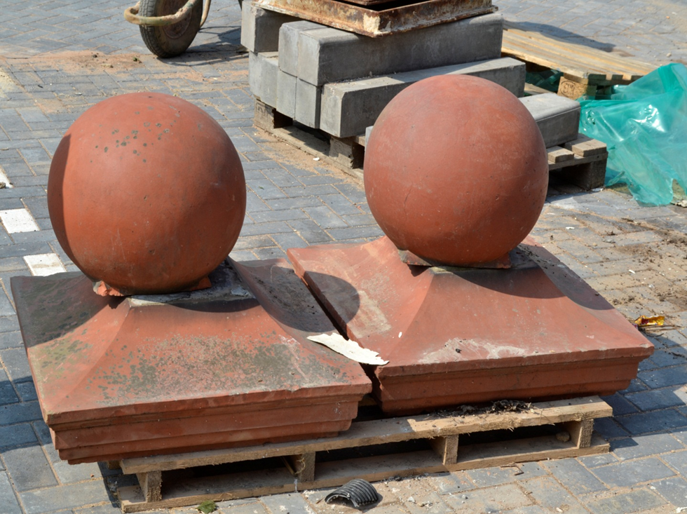
Boundary walls AND GATE PIERS with terracotta ball finialS
Terracotta ball finials during rebuilding

Slide 11
Acknowledgements
Drawing of the School c1899 with grateful thanks to Leicestershire County Records Office.
Other photographs with grateful thanks to Dr. Rod Bond and David Sharpe.

